Slide 1
Additional Features in Migori County website
By Bruno and Gordon

Slide 2
Introduction
After a wide research and consideration we saw it beneficial to add the following features in Migori county website to increase its efficiency and improve services to Migori citizens.
The features are:
Emergency page.
Embedded google map.
Chat bot.
Public Engagement portal.
Student Attachment portal.

Slide 3
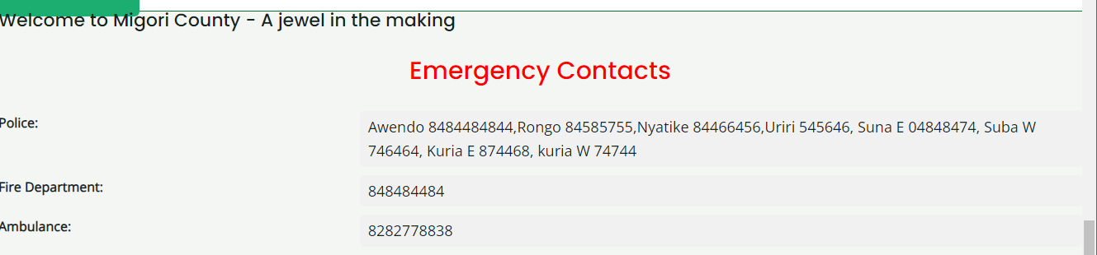
Emergency page:
This web Page contains contacts Migori citizens can call during emergency i.e incase of accident , attack and fire incidents.

Slide 4
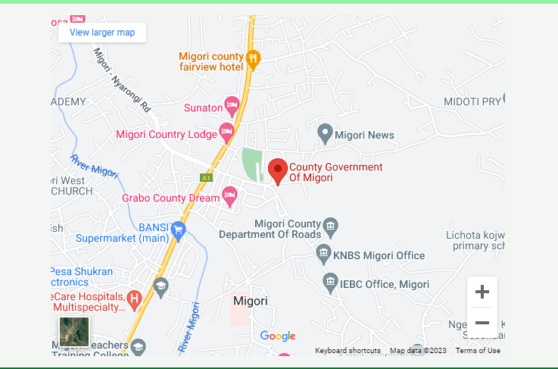
Embedded google map
This web page indicates the location of Migori county public offices making it easy for citizens to locate them.

Slide 5
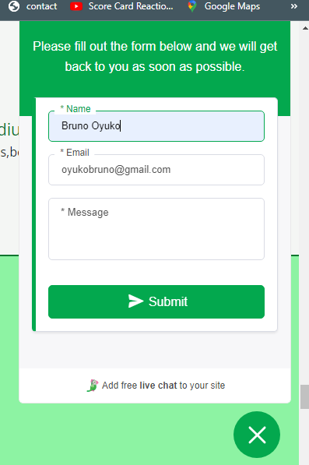
Chat bot.
We realised that the contact us button in the Migori county website is not working therefore we developed alternative that is a chat bot. This will enhance communication between citizens and administration.

Slide 6
Public Engagement portal
Generally the portal allows citizen to make complaints and suggestions on various department ,this can help improve the administration services and reduces risk involve when making a complaint.
This portal contains two main parts , admin side and citizens sides.
The portal allow citizens to do the following:
Register an account and login.
Make complaint about services offered by the administration and supporting it by documents or images.
Follow the progress of their complaint .
Receive the feedback from admin and logout.

Slide 7
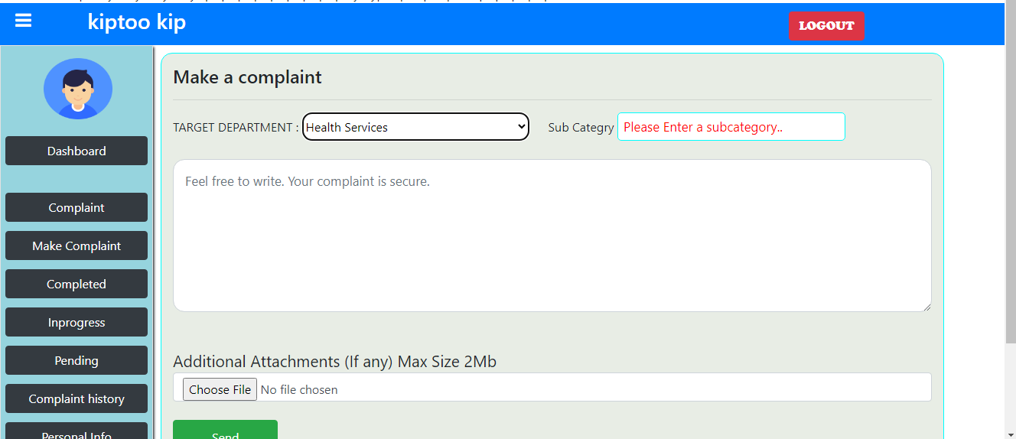
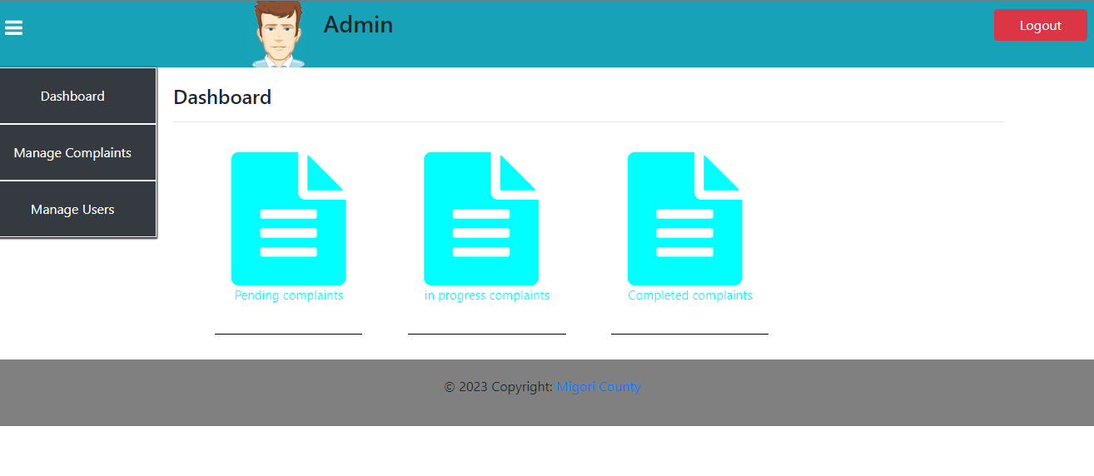
Citizen portal
Admin portal

Slide 8
Continue…
Admin has the power to do the following:
Regulate citizens account .
Read and give citizens concerning their complaint.
Have reports concerning the users of the portal.

Slide 9
Student Attachment portal
This portal allows student seeking for industrial attachment to apply for the position incase it is available.
The admin post for the vacancy to alert the public of the chance .
Students will then register and login the system to apply for the chance.
Students can upload their cv , recommendation letter from school and letter of application.
If the student meets the requirement he/she will be communicated through the email.

Slide 10
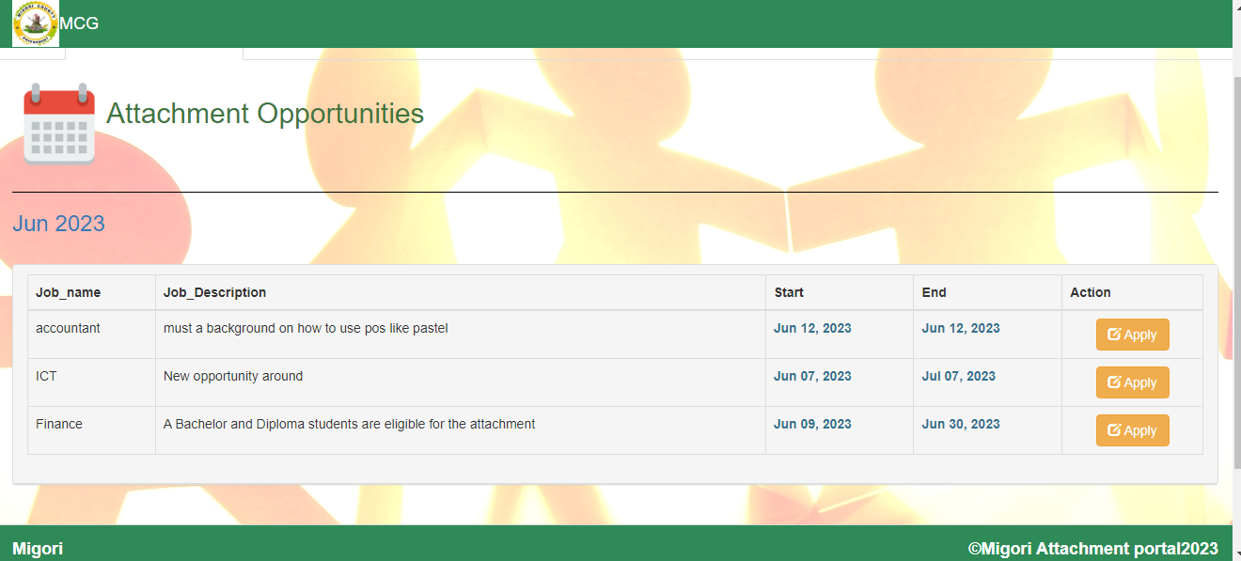
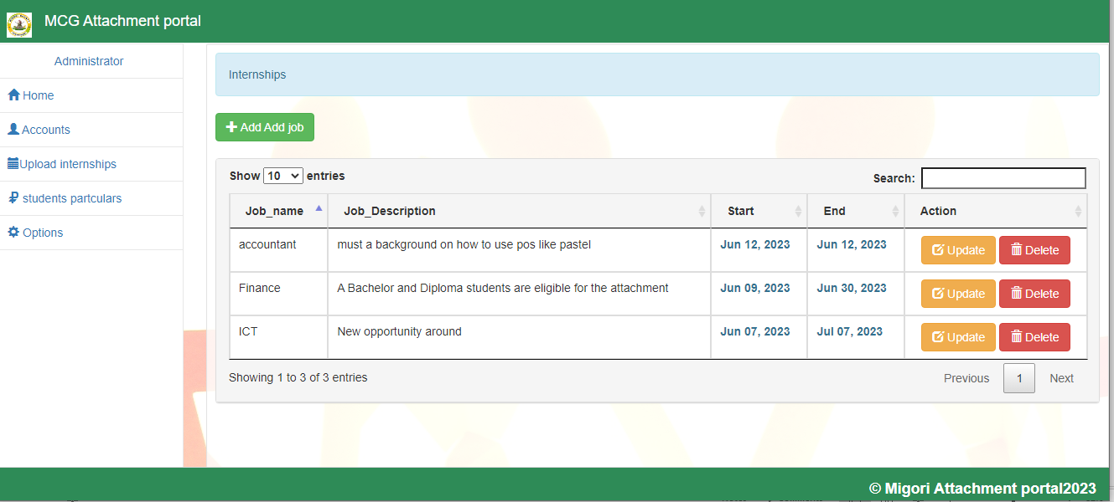
images

Slide 11
THANK YOU!
Thanks for your time.

